Slide 1

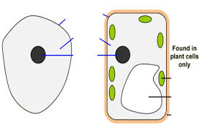
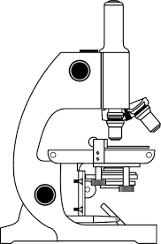
i
1.1 Cell, Tissues & Organs
M
A
Define
tissue
Organ
Organ system
Organism
Explain diffusion
What is a stem cell?
List some ethical issues
Structure | Purpose | Plant/Animal/Both
 | Controls the cells activities
Cytoplasm
 |  | Both
Nuclear membrane
 |  | Plant
 | Contain chlorophyll, absorb light energy to make food
Vacuole
Label the Cells
Label the microscope
Explain how to make an onion cell slide.
Explain how plants and animals grow
Draw and label a bacterial cell
KEY WORDS:
Nucleus Vacuole
Cellulose cytoplasm
Chloroplast chromosomes
Coverslip magnification
Plasmid diffusion
Selectively permeable
differentiate
ASSESSMENT:

Slide 2
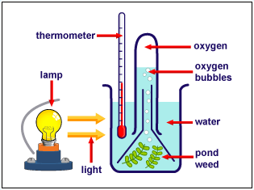
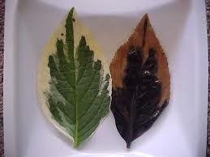
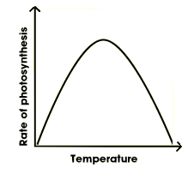
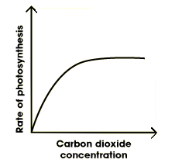
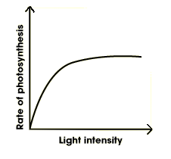
Write down the equation for photosynthesis.
Explain why chlorophyll is needed in photosynthesis.
What is the compensation point?
Label the leaf
1.2 photosynthesis
How is this used to calculate the rate of photosynthesis?
Explain this result:
What is the glucose used for from photosynthesis?
How and why would you destarch a plant?
Light absorption in a leaf is maximised by:
Describe and explain what would happen in these 3 tubes?
How could you increase the rate of photosynthesis in a greenhouse?
Explain how to carry out a starch test.
What are the limiting factors on these graphs?
Gas exchange in a leaf is maximised by:

Slide 3
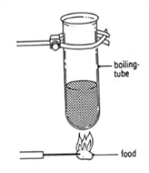
1.3 Nutrition and Health
How is this used to calculate the energy in food
Write the equation
What 3 things determine our energy needs?
What is obesity?
How do you calculate
BMI
BMR
Food group | Made up of | Function | Source
 |  | Growth and repair
Fats
 | Vitamin C
 | Vitamin D
 | Calcium
 | Iron
 | Transport medium, chemical reactions, component of cytoplasm and body fluids
Carbohydrate
Fibre
Describe the health problems which could be caused by poor diet.
Food test | Method | Positive result
Iodine (starch)
Benedicts (sugar)
Biuret (protein)
Ethanol (fats)
DCPIP (vit C)
KEY WORDS:
Nucleus Vacuole
Cellulose cytoplasm
Chloroplast chromosomes
Coverslip magnification
Plasmid diffusion
Selectively permeable
differentiate
ASSESSMENT:

Slide 4
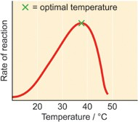
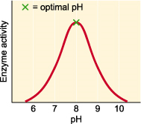
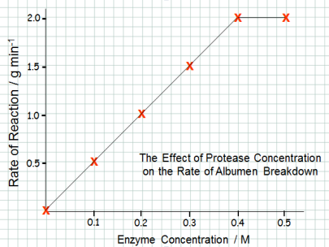
1.4 Enzymes
How enzymes work.
Explain enzyme specificity.
What is a the role of an enzyme?
What is the Lock and Key model?
Factors Affecting Enzyme Action.
Draw and label a diagram to show how an enzyme works. Label the substrate, enzyme, active site
.
Explain the following graphs
Definition of an enzyme
Biological Detergents
Enzymes in Digestion
Explain how biological detergents work.
What are their advantages and disadvantages?
Enzyme |  |  | Area of gut
Amylase
Protease
Lipase
carbohydrase
Substrate
Product
KEY WORDS:
Denatured
Enzymes
Active Site
Specificity
thermostable
ASSESSMENT:
Notes:
4

Slide 5
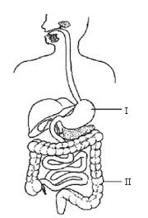
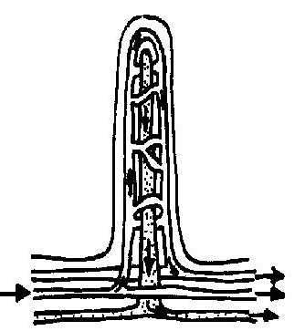
1.4 DIGESTION - breakdown of large insoluble molecules to small, soluble ones.
Annotate the following diagram (include what the structure does and any enzymes/juices produced)
Where would you find this structure?
Label the diagram
Explain how the villus is adapted to it’s function
KEY WORDS:
Villi
Digestion
Egestion
Emulsify
Permeable
Absorption
ASSESSMENT:
Notes:
5

Slide 6
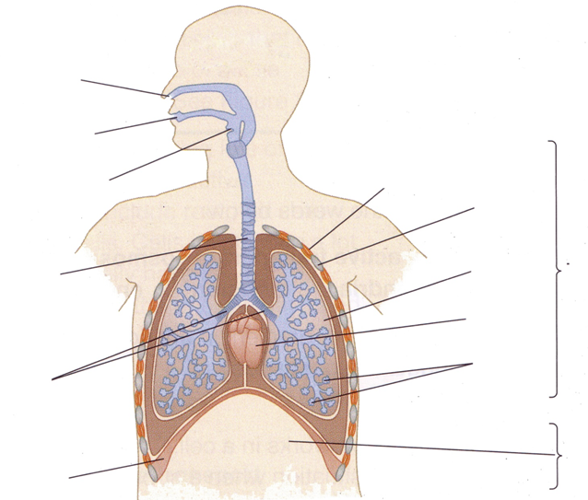
1.5 Gaseous Exchange in Animals
Label the diagram of the lungs:
What is the name for movement of gases in and out of the lungs?
What is the function of respiratory system?
Describe the stages of inhalation:
Describe the stages of exhalation:
Describe the changes that will occur in the respiratory system during exercise:
Notes:
6

Slide 7

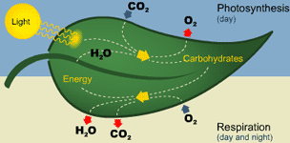
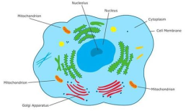
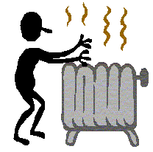
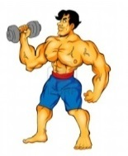
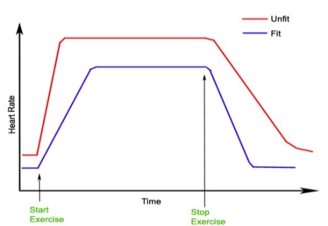
1.5 ENERGY FROM RESPIRATION
Write down the equation for aerobic respiration:
Key concept
Remember that plants do photosynthesis AND respiration
Respiration is controlled by e ________________
It takes place all the time in a___________ and p________________.
Is called aerobic respiration because it uses o______________
Respiration takes place in the m________________.
Reasons for respiration
Write down the equation for anaerobic respiration:
Where and when does anaerobic respiration take place?
Why do muscles become fatigued if you exercise hard?
Why is anaerobic respiration much more inefficient than aerobic?
What is oxygen debt?
The fit person has a ______________resting heart rate, before they begin to exercise
The fit persons heart rate rises more ______________
The maximum heart rate reached by the fit person is a lot __________________than the unfit person
The fit persons heart rate drops ____________when they finish exercise
The heart rate of the fit person returns to their resting heart rate in a _________________time.
The response to exercise:
Heart rate →
Breathing rate →
Notes:
7

Slide 8
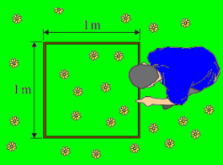
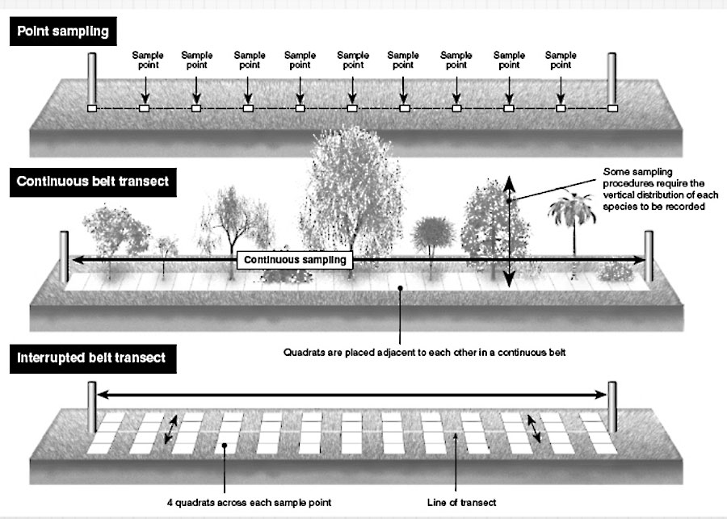
1.7A Organisms in their environment
Term | Definition
Species
Population
Community
Environment
Habitat
Biodiversity
Ecosystem
Key definitions & egs:
Producer :
Consumer :
Trophic level:
Quadrats
What is a quadrat?
What do we use it for?
What do you do to get valid results?
Is it random?
Transects
What is the most common type of transect?
What do we use a transect for?
Explain how do you use a transect
Is it random?
Notes:
8

Slide 9
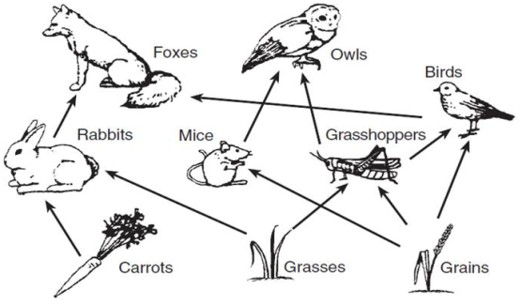
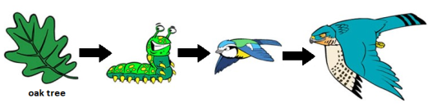
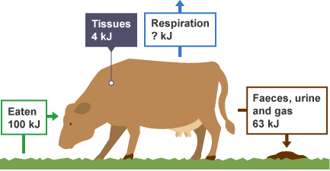
1.7A ENERGY FLOWS
What is the main source of energy for living things?
Draw a pyramid of numbers for this food chain.
What would happen if the rabbits died of a disease?
Complete the information about the 5 kingdoms.
 | Cell wall | Nutrition | Cell organisation
Bacteria
Protoctista
Fungi
Plants
Animals
Calculate the amount of energy lost due to respiration (heat & movement).
What is biomass?
Why do numbers and biomass decrease as you move up a food chain?
Why do we classify organisms?
Calculate the percentage of the energy eaten which is used to produce new tissue.
KEY WORDS:
Biomass
Energy
Pyramid of numbers
Kingdom
Classification
ASSESSMENT:
Notes:
9

