Slide 1
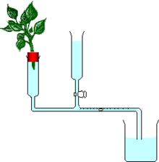
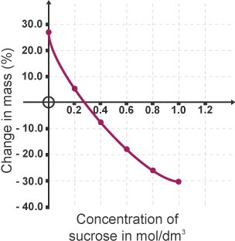
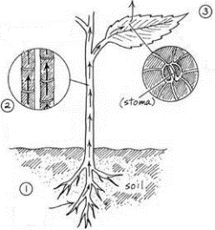
UNIT 2.1 OSMOSIS & TRANSPORT IN PLANTS
What is osmosis?
What is the name for this piece of equipment:
Label the diagram
How can it be used to measure transpiration?
How could you measure the effect of temperature on transpiration rate?
* Complete the diagram of a plant cell that has been in a conc sugar soln for 30 mins.
* Explain your diagram…
Draw arrows on the cell to show the movement of water.
Describe why water moves this way..
What will happen to the cell?
Conc. solution
Dilute solution
KEY WORDS
Selectively permeable; diffusion; osmosis; concentration gradient; turgid; plasmolysed; wilt; lysis; crenation; root hair cell; xylem; stomata; air spaces; transpiration stream; potometer; reservoir;
Why record % change in mass?
Mark on the graph the conc. of the cells
Use the graph to describe the difference between potato tissue placed in dilute and concentrated sucrose solutions…
What do the arrows represent?
Describe how water enters at 1…
name the vessels that carry water
What is water used for in the plant?
how does water leave the plant at 3?
Notes:
1

Slide 2
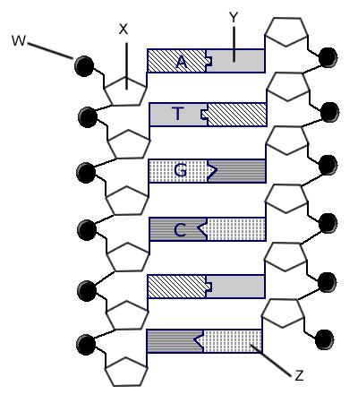
2.3 Chromosomes, Genes and DNA
What are chromosomes and where are they found?
.
State how the base triplet hypothesis explains the link between the DNA code and the formation of proteins.
What is a gene?
Describe how the work of Chargaff, Franklin and Wilkins and Watson and Crick led to the discovery of DNA (What approaches did they use and what did each of them discover)?
Annotate the diagram below which illustrates a short length of DNA .
What is peer review and why is it useful?
Assessment
KEY WORDS
Nucleus DNA X-Ray Diffraction
Chromosome Nucleotide Modelling
Gene Base Triplet Base
Protein Double helix Amino Acid

Slide 4
Mitosis , Meiosis & Pedigree diagrams
Complete the table below to illustrate the main differences between mitosis and meiosis.
Define the following terms:
Gene:
Allele:
Homozygous:
Heterozygous:
Recessive:
Dominant:
Description | Mitosis | Meiosis
Example
Genetic Information
No of divisions
No of daughter cells.
Independent Assortment

Slide 5
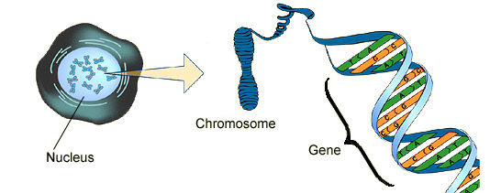
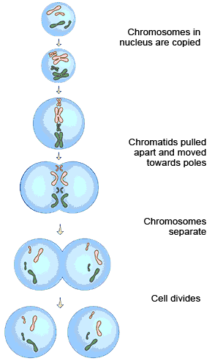
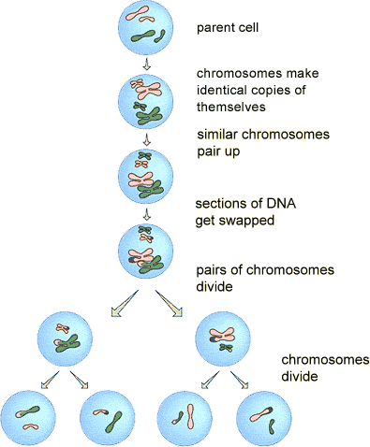
UNIT 2.2 DNA & CELL DIVISION
Labe l the diagram:
A gene is a section of D____. It controls a c____________ of your body. You have ___ chromosomes in the n______ of your b_______ cells. Arranged in _____ pairs. One of each pair is inherited from your m________ and one from your f_________. Your sex cells or g_________ only have _____ chromosomes.
Other key terminology:
Differentiation:
Fertilisation:
Variation:
Stem cells
Future of stem cell research
Function
Uses
Problems
What is the name of this process?
Write down an explanation of what is happening at each stage in the boxes.
How many daughter cells produced?
Are the genes identical or different to parental cell?
Why and where do cells undergo mitosis?
A mnemonic for mitosis:
“Mitosis goes on in my toes, and toes are not sexy”
What is the name of this process?
Write down an explanation of what is happening at each stage in the boxes.
How many daughter cells produced?
Are the genes identical or different to parental cell?
Why and where do cells undergo meiosis?
Notes:
5

Slide 6
UNIT 2.3 SIMPLE INHERITANCE
What is mitosis and why is it needed?
What is differentiation?
How does it differ in plants and animals?
What is meiosis?
Why is it important?
How does it help generate variation?
What are stem cells?
State 2 uses of stem cells:
State 2 problems with stem cell research:
Chromosomes are made of long strands of what?
Small sections of this are called what?
What do genes code for?
What is DNA fingerprinting?
How many chromosomes in a) gamete and b) somatic cell?
What is an allele?
What does a) dominant; and b) recessive mean?
What is Cystic Fibrosis and what causes it?
Draw the punnet's square for 2 CF carriers
KEY WORDS:
Alleles
Mitosis
Meiosis
Stem cells
Therapeutic cloning
Mendel
DNA finger printing
Chromosomes
Dominant
Recessive
Polydactyly
Cystic fibrosis
ASSESSMENT:

Slide 7
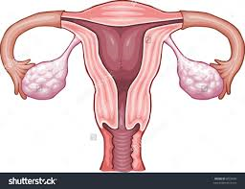
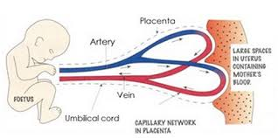
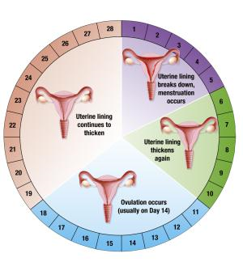
UNIT 2.4 FERTILITY & REPRODUCTION
How are sperm and egg cells specialised?
Label the diagram of the uterus
Draw & label the amnion.
Mark:
W – where sperm are deposited
X – where an egg is produced
Y – where fertisation takes place
Z – where the zygote implants
Explain the role of the placenta and umbilical cord:
Key words:
Gamete
Fertilisation
Haploid
Diploid
Meiosis
Mitosis
Zygote
Embryo
Uterus
Placenta
Umbilical cord
Amnion
Menstruation
Ovulation
Contraception
Fertility
In vitro fertilisation
Highlight every word you can define
List the main causes of infertility:
Write ‘a’ or ‘b’ beside each problem to show the best treatment:
Fertility drugs
In vitro fertilisation (IVF), test-tube babies
Label the diagram to show when menstruation and ovulation occur
gggggg
Type | Example | Method | Advantage | Disadvantage
Mechanical |  | Barrier | Protects against STDs | Unreliable
 | Pill |  | Very reliable
 |  | Cutting sperm tubes | ~100% reliable | Irreversible
 | Female sterilisation |  | ~100% reliable | Irreversible

Slide 8
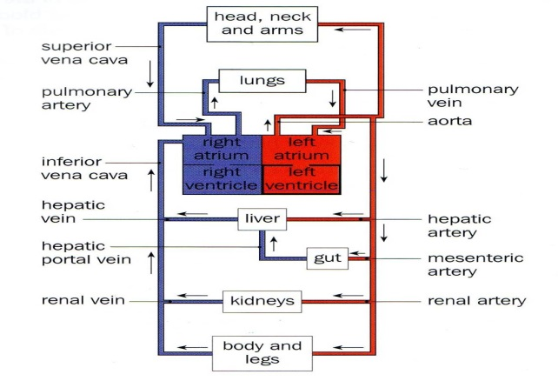
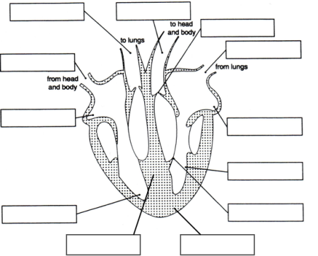
UNIT 2.7 CIRCULATION
State the 4 main components of blood:
What are the functions of these 4 components?
Name the three main types of blood vessel
Draw & complete a table with the following columns: Vessel; Thickness of walls; & direction of blood flow
Complete labels & learn!
What are the risk factors for heart disease?
What is the effect of exercise on heart rate?
Draw & learn a diagram to show how tissue fluid and lymph are formed
What are the risk factors for strokes?
Hot question –why are people with anaemia tired all the time?
KEY WORDS:

Slide 9
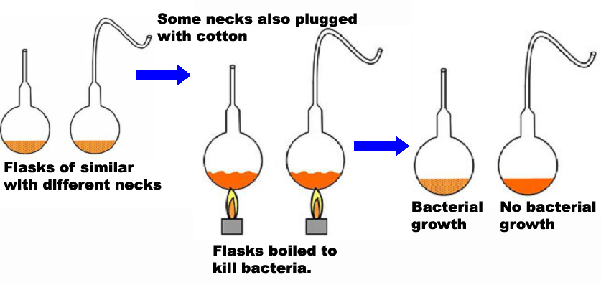
GCSE Disease and Body Defences - Summary (Part 1)
Types of Microorganisms
Body Defences 1
Explain how the following stop harmful microorganisms from entering the body:
Skin
Mucous membranes
Clotting
Pasteur’s Experiment
List diseases caused by:
Bacteria
Viruses
Fungi
Conclusion:
Explain what Pasteur had to do to get valid results
Body defences 2. Role of White Blood Cells (Lymphocytes and Phagocytes)
1. Microorganisms have a_____________ on their surface. These cause l_____________ to produce antibodies. The antibodies latch on to the a_____________ due to the complementary shape. This causes clumping which immobilises the microorganisms.
2. Once the microorganisms are clumped together they are destroyed by phagocytes in a process called p______________. The phagocyte surrounds, engulfs and breaks down the microorganism.
KEY WORDS:
Microorganism Defence
Virus Fungi
Bacteria Antibodies
Lymphocytes Phagocytes
Phagocytosis Immunity
Active Passive
Vaccination Mucous
Engulf Membrane
Vaccinations
Vaccinations contain dead or weakened microorganisms.
The a__________ on these cause lymphocytes to produce a____________.
The antibodies latch on to the antigens due to the c________ shape causing c_______ which immobilises the microorganisms.
They are then destroyed by phagocytosis.
Long term immunity is achieved because antibodies are produced by the body so it is a__________ immunity.
Describe the work of Edward Jenner
Summarise the main differences between active and passive immunity.

