Slide 1
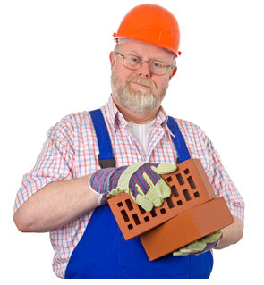
edward
Age: 59 Lifestyle: married,
Height: 1.76m one adult child,
Weight: 98kg 2 grandchildren,
Occupation: bricklayer watches TV

Slide 2
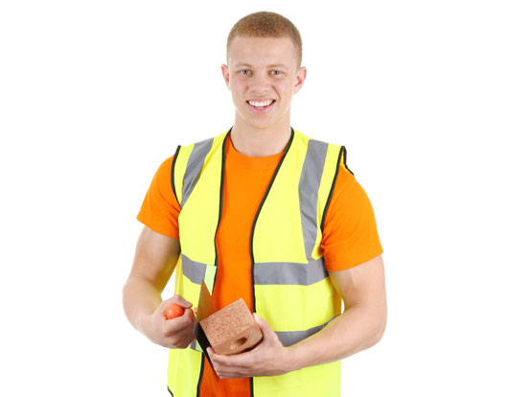
ANGUS
Age: 24 Lifestyle: single,
Height: 1.78m motorcycling,
Weight: 80kg clubbing
Occupation: bricklayer

Slide 3
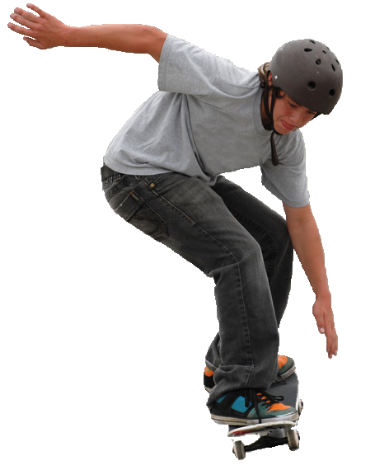
david
Age: 15 Lifestyle:
Height: 1.46m learning piano,
Weight: 51kg skateboards
Occupation: school child

Slide 4
patrick
Age: 35 Lifestyle: single,
Height: 1.82m listening to music,
Weight: 75kg plays snooker
Occupation: nurse

Slide 5
SUE
Age: 49 Lifestyle: married,
Height: 1.51m two teenage children
Weight: 47Kg charity work
Occupation: teacher

Slide 6
AMY
Age: 8 Lifestyle: Brownies,
Height: 1.28m karate
Weight: 30kg
Occupation: school child

Slide 7
JENNIFER
Age: 24 Lifestyle: married,
Height: 1.70m eating out,
Weight: 55Kg plays netball
Occupation: computer programmer

Slide 8
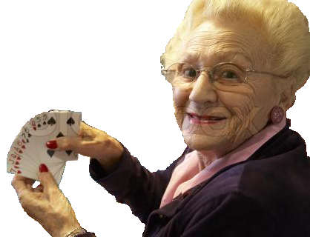
MARIE
Age: 75 Lifestyle: widowed,
Height: 1.57m playing bridge,
Weight: 50kg playing with
Occupation: retired grandchildren

Slide 9
MIA
Age: 24 Lifestyle: pregnant,
Height: 1.70m walking the dog,
Weight: 68kg swims
Occupation: artist

Slide 10
NAME | AGE | ENERGY REQUIREMENTS / kJ
ANGUS | 24 | 10627
DAVID | 15 | 10633
PATRICK | 35 | 10386
EDWARD | 59 | 10127
MIA | 24 | 9543
JENNIFER | 24 | 7943
SUE | 49 | 7943
AMY | 8 | 6397
MARIE | 75 | 6298

