Slide 1
The Ultimate Guide to Astronomy Controlled Assessment

Slide 2
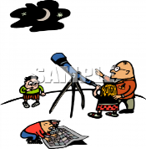
What is Astronomy Controlled Assessment?
Unit 2 of GCSE Astronomy is a teacher-marked assessment of two observational projects, one of which, must be carried out without optical aids and one of which must involve the use of binoculars, camera, telescope, sundial or some other suitable equipment.
One project should be UNAIDED
The other project should be AIDED

Slide 3
In my controlled assessment
Unaided coursework was viewing constellations in the night sky.
The aided coursework was viewing Messier Objects using the Faulkes telescopes in Hawaii.

Slide 4
Tips before you start…….
I think a new folder is essential- this ensures all your notes will be in the one place and no stray sheets will be getting lost
Date all your work
Write where you did each observation ( this is important later )

Slide 5
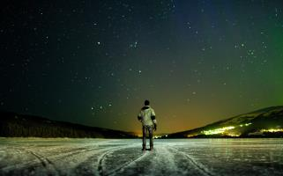
What will you be assessed on?
The quality of each project will be assessed in four key skill areas:
Design;
Observing;
Analysis;
Evaluation.

Slide 6
Design your observation… You can maybe use this as an introduction…
You will need to consider:
the astronomical object(s) that you want to observe;
where you are going to carry out your observations;
what equipment you will need;
the date(s) and time(s) when you plan to observe;

Slide 7
Always Explain WHYYY
So why would you choose to observe on a particular night?
Well personally I would plan to observe on a definitely clear night, I would even take screenshots of the Metoffice to show
‘I have planned to go observing on March 3rd 2017 at 8pm as the MetOffice and other reliable weather sources suggest it is going to be a clear night!

Slide 8
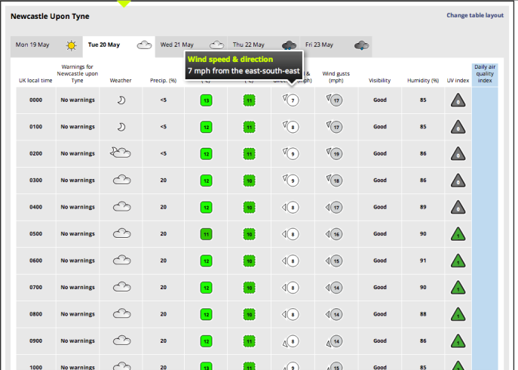

Slide 9
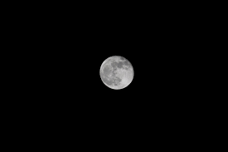
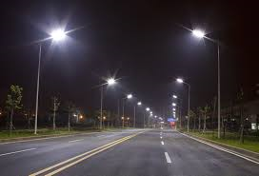
Where and why are you observing there?
Choose the place you want to observe carefully
Assess;
Will it be near a road, street lamps or a housing estate?
I suggest that you do observations in places with different lighting conditions….

Slide 10
For example……In your Evaluation…
When I did controlled assessment we observed constellations
I decided that I wanted to do observations of the constellations in light polluted conditions and also in dark conditions so that when I rated the magnitudes of the stars, I could explain that the light pollution would have affected my judgement of how bright the stars were.

Slide 11
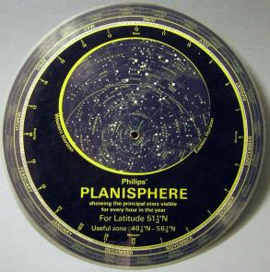
When choosing objects you want to observe….
You must choose objects that are going to be in the Northern Hemisphere an also going to be above the horizon on the dates that you are planning to observe it….
E.g Orion is only able to be observed in the winter!!
You can use a Planisphere and Stellarium to check if the objects you require are going to be in the sky at that particular time.

Slide 12
Don’t panic
Be detailed- you will be thankful when it comes to your analysis ( as if you are detailed enough when you are actually doing the observing, the analysis will already be nearly finished!!)
Enjoy it – its not every day your work is looking at pretty things in the sky

