Slide 1

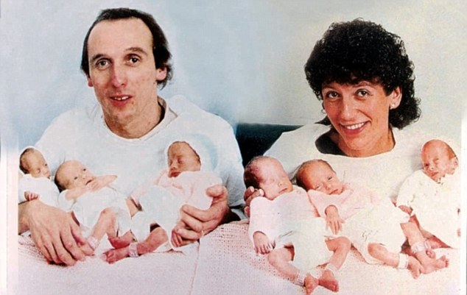
Glenlola Collegiate School
excellence through commitment, contribution and caring
2.4 Reproduction
Notes:
Graham and Janet Walton had tried IVF before conceiving the sextuplet girls naturally

Slide 2
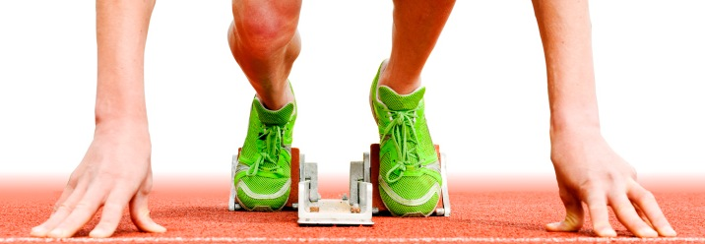
starter activity
Use your knowledge from KS3 to match the labels and functions to the diagrams of the male and female reproductive systems.
Notes:
Test prior knowledge

Slide 3
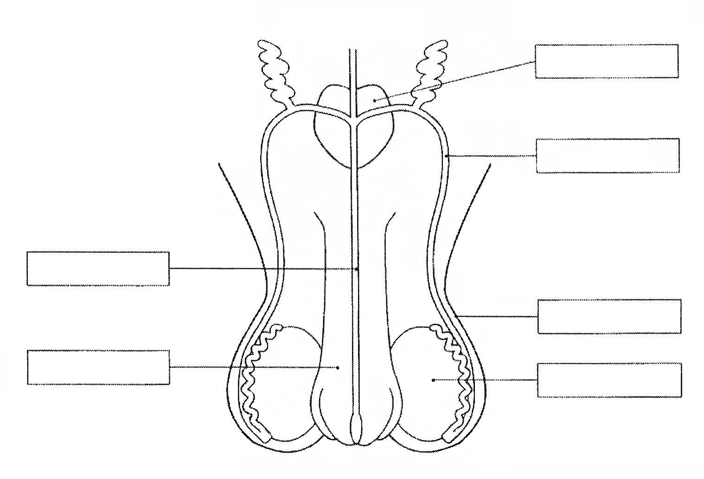
Male Reproductive
system
prostate gland
produces fluid in which
sperm swim
sperm duct
carry sperm from
testes to penis
urethra
carries sperm and urine
out of the body
(at different times)
scrotum
sac containing testes
penis
testes
organ placed into
the vagina
to deliver sperm
where sperm are made

Slide 4
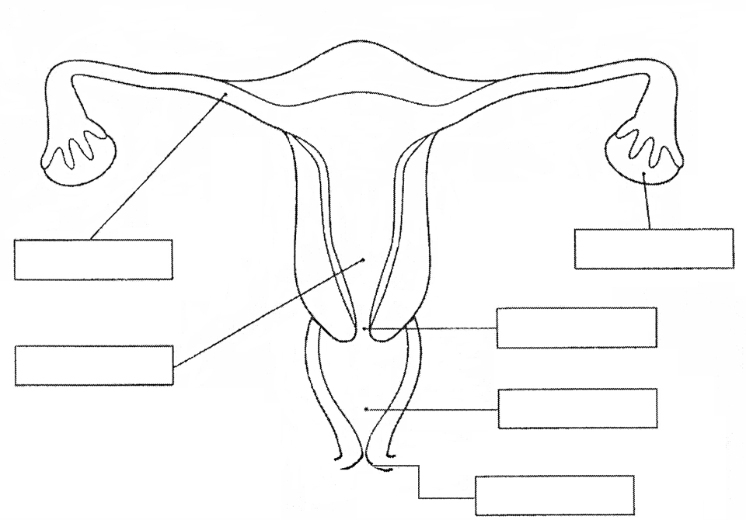
Female Reproductive
system
ovary
oviduct
where ova are made
carries ova from
ovary to uterus
cervix
uterus
ring of muscle, closes uterus
muscular organ where
fertilised ovum
embeds and grows
vagina
where sperm are deposited
during intercourse
vulva
opening to the vagina

Slide 5

LEARNING
OUTCOMES
ALL MUST…
know that sperm cells are specialised cells formed by meiosis, followed by differentiation in the testes under the influence of the hormone testosterone;
know that sperm cells are adapted to their function by having a haploid nucleus and a tail for swimming;

Slide 6
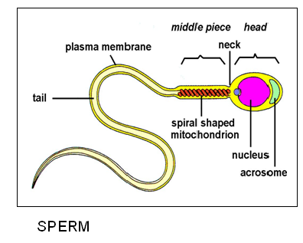
Adaptations of sperm cells
Sperm cells are the male sex cells or gametes.
They are specialised cells
formed by meiosis.
Sperm cells are haploid. This means that their nucleus contains
half the total number of
chromosomes.
The hormone testosterone
causes cells in the testes
to differentiate into
sperm cells.
Sperm have a tail to help
them swim to the ovum.
Notes:
Get pupils to draw a sperm cell on a white board & label the adaptations

Slide 7

The events leading to pregnancy entrance/ exit quiz
Notes:
Use to test prior knowledge/ what you have taught at the end of one lesson or the start of another. Quick Key app 5 multiple choice questions. You can use the app to scan in the answers and analyse them, or you can just mark as normal.

Slide 8
Ovulation is…
A The release of an ovum from the ovary
B The swimming of a sperm to the ovum
C The joining of an ovum and a sperm nucleus
D The passage of the ovum along the oviduct
E the attachment of a fertilised ovum to the uterus wall
A

Slide 9
Fertilisation is…
A The release of an ovum from the ovary
B The swimming of a sperm to the ovum
C The joining of an ovum and a sperm nucleus
D The passage of the ovum along the oviduct
E the attachment of a fertilised ovum to the uterus wall
C

Slide 10
Implantation is…
A the release of an ovum from the ovary
B the swimming of a sperm to the ovum
C the joining of an ovum and a sperm nucleus
D the passage of the ovum along the oviduct
E the attachment of a fertilised ovum to the uterus wall
E

Slide 11
LEARNING
OUTCOMES
ALL MUST…
fertilisation takes place in the oviducts when the sperm and the haploid egg nucleus fuse to give a diploid zygote;
the zygote divides by mitosis many times to form a ball of cells as it travels down the oviduct to the uterus;

Slide 12
THE EVENTS LEADING TO PREGNANCY
1. ovulation
2. fertilisation
3. implantation

Slide 13
Ovulation is the release of an ovum from an ovary.
It occurs once every 28 days, approximately mid cycle.

Slide 14
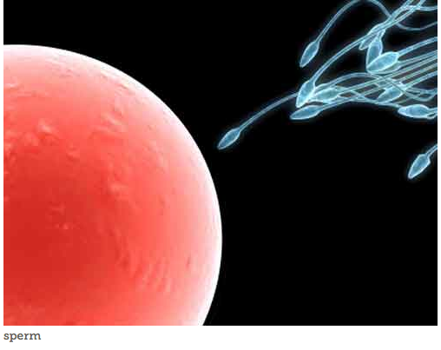
Fertilisation
Notes:
Click the image to load the YouTube clip. Play as far as 2mins 45s. BIG QUESTION: what happens next? How? Need idea that sperm uses enzymes to break down the membrane of the egg cell.

Slide 15
Fertilisation occurs when the haploid sperm nucleus joins with the haploid ovum nucleus.
It occurs in the oviduct as the ovum travels towards the uterus.

Slide 16
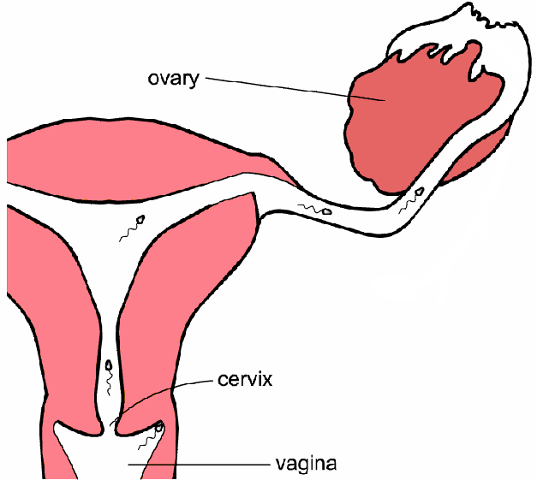
Following ovulation the ovum travels down the oviduct
Sperm swim through uterus and into oviduct
Fertilisation occurs in the oviduct
Ejaculation sperm left at top of vagina

Slide 17
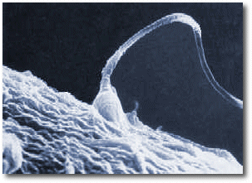
Events following fertilisation

Slide 18
The fertilised cell formed is called a zygote.
The zygote is diploid
The zygote divides by mitosis to form a ball of cells as it travels down the oviduct to the uterus

Slide 19
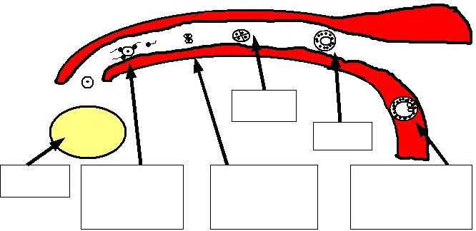
4 cells
Ball of
cells
ovary
Zygote
divides by
mitosis
Embryo sinks
into soft
uterus lining
Ovum
fertilised

Slide 20
Implantation
occurs when the ball of cells attaches to the wall of the uterus.
The cells are now called an embryo.
After implantation the embryo differentiates to produce different tissues and organs.

Slide 21
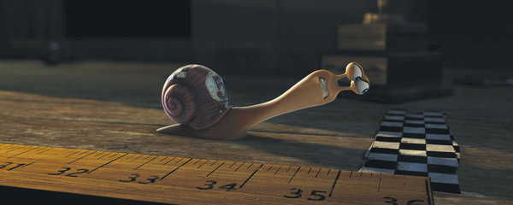
plenary
Pupils to use whiteboards to draw a diagram to link terms ovum, sperm, zygote, embryo and foetus.

Slide 22
LEARNING
OUTCOMES
ALL MUST…
after implantation in the uterus lining the ball of cells then differentiates to produce a variety of tissues and organs

Slide 23
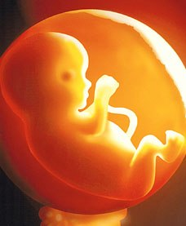
starter activity
Jot down on the whiteboard the features in the photograph that help to support the developing foetus.
Notes:
From this distinguish between respiration & breathing.

Slide 24
Development of the Foetus
A number of special features support the developing foetus, including the amnion, amniotic fluid, umbilical cord and placenta.

Slide 25
LEARNING
OUTCOMES
ALL MUST…
the amnion and amniotic fluid cushion the foetus.

Slide 26
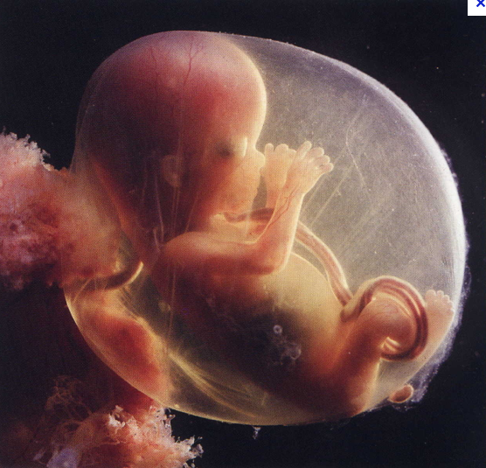
The amnion is a sac filled with
amniotic fluid
which cushions the foetus against knocks and bumps as it develops

Slide 27
uterus wall
amnion
amniotic fluid
placenta
umbilical
cord
foetus
vagina

Slide 28
LEARNING
OUTCOMES
ALL MUST…
the placenta is adapted for diffusion by having a large surface area for exchange of dissolved nutrients, oxygen, carbon dioxide and urea.
SOME MAY…
explain the role of villi in providing these adaptations;
HIGHER
TIER

Slide 29
LEARNING
OUTCOMES
ALL MUST…
know that these substances are carried to or from the foetus in the blood vessels in the umbilical cord;

Slide 30
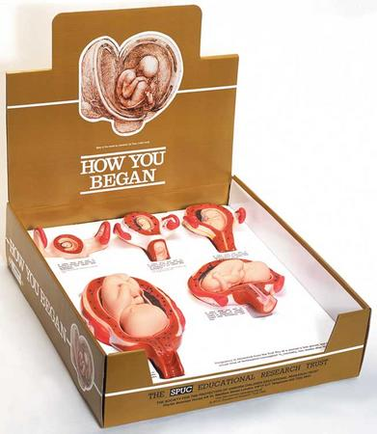
activity
Look at the SPUC model babies and examine how they are connected to the wall of the uterus.
What features make it good as an exchange surface?
Notes:
From this distinguish between respiration & breathing.

Slide 31
The placenta
is an exchange surface for gases and nutrients. It is highly folded to increase the surface area for diffusion.

Slide 32
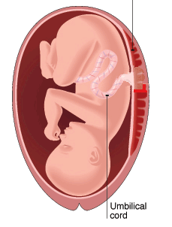

placenta
Umbilical cord
joins placenta

Slide 33
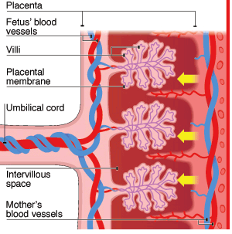

Slide 34
The end of the umbilical cord folds into villi, giving it a very large surface area for exchanging substances.
The placenta has spaces that are filled with the mother’s blood and surround the villi.
The baby’s blood and the mother’s blood are separated by only a few cells.

Slide 35
Umbilical artery carries blood rich in carbon dioxide and urea from the embryo to the placenta.
Umbilical vein carries blood rich in oxygen, glucose and amino acids from the placenta to the embryo.

Slide 36
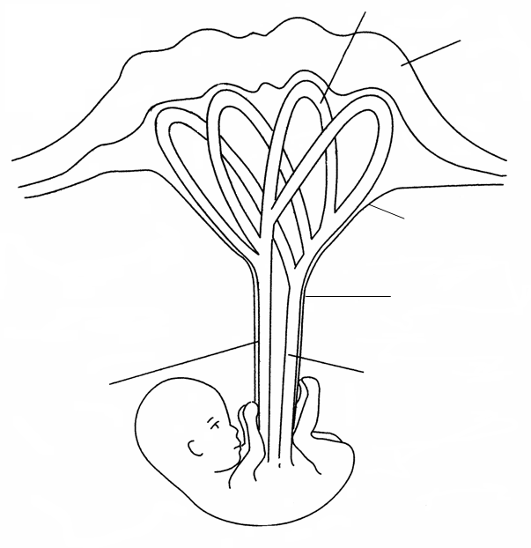
urea
Baby’s blood
oxygen
Carbon
dioxide
Mother’s blood
glucose,
amino acids,
vitamins etc
placenta
Umbilical cord
Umbilical
artery
Umbilical
vein

Slide 37
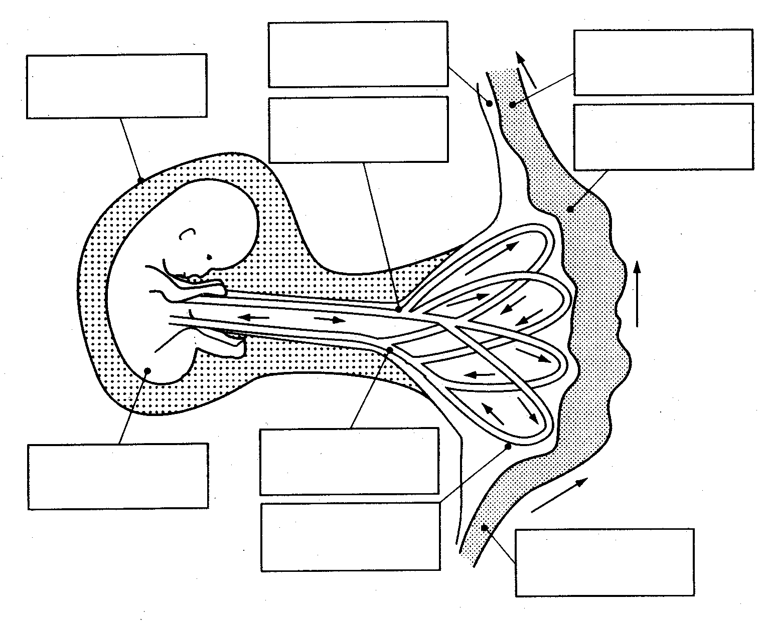
Uterus lining
Deoxygenated
blood of mother
amnion
Artery in umbilical cord
(deoxygeneated blood)
Blood space
in uterus
Vein in umbilical cord
(oxygeneated blood)
embryo
Capillary network
in placenta
Oxygenated
blood of mother

Slide 38
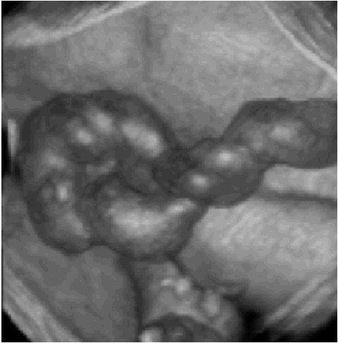
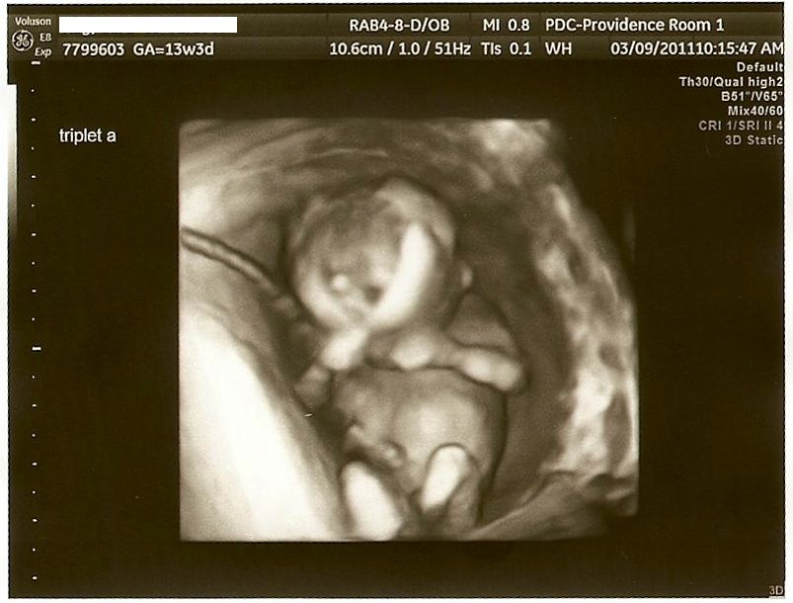
Notes:
3D image of umbilical cord. The 2nd image shows the cord around the babies neck, but apparently its ok at this point of development!

Slide 39
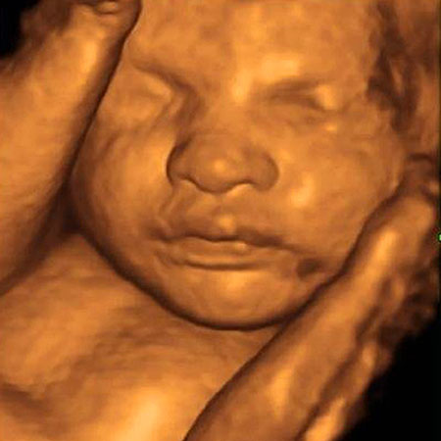
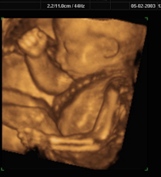
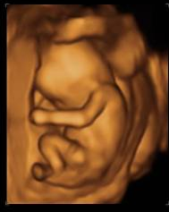
Notes:
Just more pictures because they always ask!

Slide 40
LEARNING
OUTCOMES
ALL MUST…
Describe the events of the menstrual cycle:
menstruation,
ovulation
the period when fertilisation is most likely to occur

Slide 41
starter activity
Pupils draw a line on whiteboard labelled 1-28
Label where menstruation & ovulation occur
draw a diagram underneath to represent the thickness of the uterus wall at the start and days 7, 14, 21 & 28.
Notes:
Test prior knowledge

Slide 42
the menstrual cycle
now complete the cloze paragraph in your notes
Notes:
This connects to www.skoool.co.uk it is on the KS3 section. You will need to scroll down to the bottom to get menstruation.

Slide 43
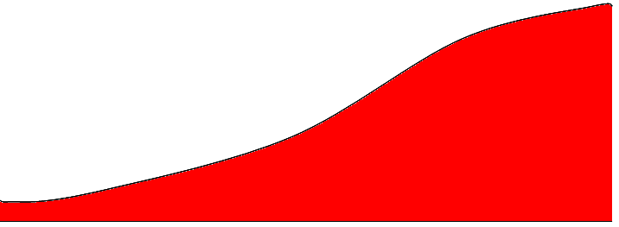
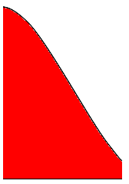
menstruation
lining builds up
1 | 2 | 3 | 4 | 5 | 6 | 7 | 8 | 9 | 10 | 11 | 12 | 13 | 14 | 15 | 16 | 17 | 18 | 19 | 20 | 21 | 22 | 23 | 24 | 25 | 26 | 27 | 28
ovulation
Uterus lining

Slide 44
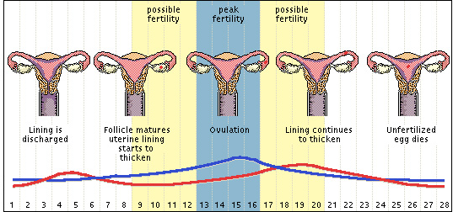
Fertilisation can only occur when an egg cell is present!

Slide 45
LEARNING
OUTCOMES
ALL MUST…
Examine how different methods of contraception work and evaluate the advantages and disadvantages of each to include;
mechanical
chemical
surgical

Slide 46
mechanical – the condom as a barrier to prevent the passage of sperm and also prevent the spread of sexually transmitted infections, some of which can lead to infertility if left untreated (gonorrhoea, Chlamydia and HIV leading to AIDS);
chemical - the contraceptive pill that changes hormone levels and stops the development of the ovum;
surgical – male and female sterilisation to prevent the passage of sperm and ova respectively

Slide 47
LEARNING
OUTCOMES
ALL MUST…
An awareness that contraception can cause ethical issues for some people.

Slide 48

Contraception
What’s in the Bag

Slide 49
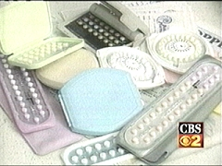

Slide 50
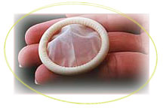

Slide 51
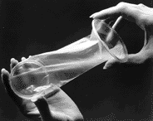

Slide 52
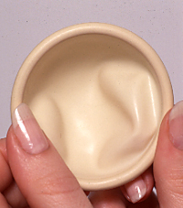
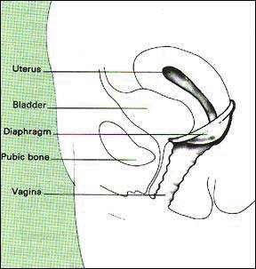

Slide 53
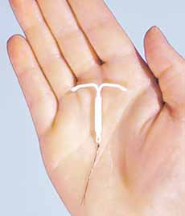
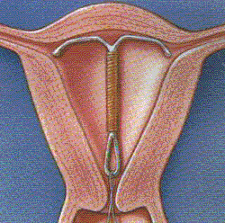

Slide 54
Look at all the methods of contraception and divide them into:
Mechanical
Chemical
Surgical
By shading each type a different colour
REMEMBER TO WRITE A KEY!

Slide 55
Surgical methods
This is a permanent method of contraception, used mainly by couples who have decided they do not want more children.
Cutting the oviduct prevents sperm reaching the ovum.
Cutting the sperm duct prevents sperm entering the semen.
Blocking the path of eggs and sperm prevents fertilisation.

Slide 56
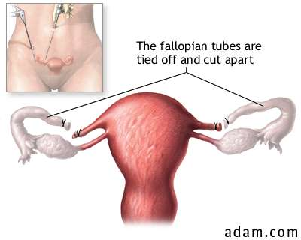

Slide 57
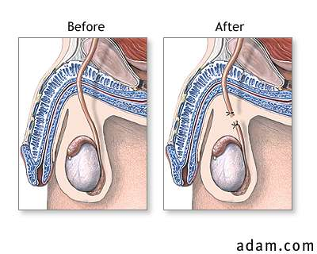
The sperm duct is cut and tied

Slide 58
LEARNING
OUTCOMES
ALL MUST…
Know that testosterone (produced by the testes) and oestrogen (produced by the ovaries) are sex hormones, recalling the secondary sexual characteristics they cause to develop;

Slide 59
starter activity
Pupils suggest the site of the production of the male and female sex hormones.
Pupils suggest the effects of the male and female sex hormones.
Notes:
Test prior knowledge

Slide 60
puberty
Puberty occurs between the ages of about twelve and fourteen
A hormone released from the brain causes the testes and ovaries to release sperm and ova
They also produce sex hormones (testosterone in the testes and oestrogen in the ovaries) which bring about changes to the body associated with puberty
These changes are called secondary sexual characteristics

Slide 61
Girls
growth spurt
development of body hair
(armpits and pubic region)
growth of breasts
menstruation

Slide 62
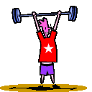
Boys
        growth spurt
        development of body hair (armpits and pubic region)
        facial hair
        voice deepening
        growth of testes and penis

Slide 63
LEARNING
OUTCOMES
ALL MUST…
Explain some of the causes of infertility and developments in fertility treatment:
the use of hormones to produce multiple ova;
in vitro fertilisation;
the transfer of several embryos into the uterus;

Slide 64
LEARNING
OUTCOMES
ALL MUST…
Understand some of the controversy associated with these techniques and their ethical implications

Slide 65
starter activity
Pupils watch the video on fertility treatment
https://www.youtube.com/watch?v=xxikBXMzkXk
Notes:
Test prior knowledge

Slide 66
Fertility problems
Read the information sheet in your booklet and draw a mind map to summarise the information
Notes:
You could photograph some of the answers and show them through apple TV, to discuss.

Slide 67
Infertility and Ethics
There is still controversy associated with these techniques and they raise ethical issues for some people.
Considering all you have learned,
think of two questions relating to
the ethics of fertility treatment
which you could ask an expert.

Slide 68

QUESTIONs ???
HOMEWORK booklet

Slide 69
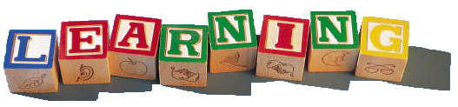
http://www.bbc.co.uk/education/topics/zd77hyc

Slide 70
mind map
simplemind+

Slide 71
robert winston
dvd

